Slide 1
Face Recognition
MAN-522: Computer Vision

Slide 2
Face Recognition
Introduction
Face recognition algorithms
Comparison
Short summary

Slide 3
Face Recognition Algorithms
We will introduce
  Eigenfaces
  Fisherfaces

Slide 4
Eigenfaces
Developed in 1991 by M.Turk
Based on Principal Component Analysis (PCA)
Relatively simple
Fast
Robust

Slide 5
Eigenfaces
PCA seeks directions that are efficient for representing the data
not efficient
efficient
Class A
Class A
Class B
Class B

Slide 6
Eigenfaces
PCA maximizes the total scatter
scatter
Class A
Class B

Slide 7
Eigenfaces
PCA reduces the dimension of the data
Speeds up the computational time

Slide 8
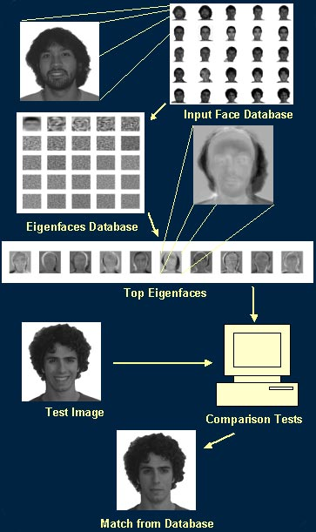

Slide 9
Eigenfaces, the algorithm
Assumptions
  Square images with Width = Height = N
  M is the number of images in the database
  P is the number of persons in the database

Slide 10
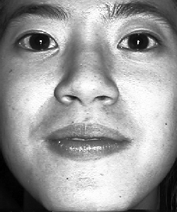
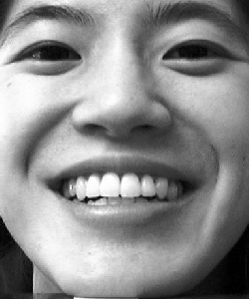
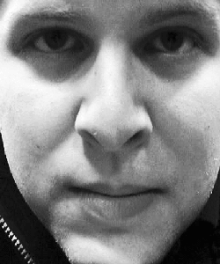
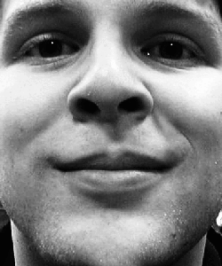
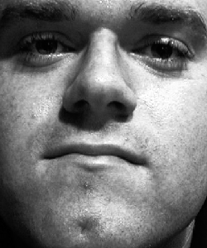
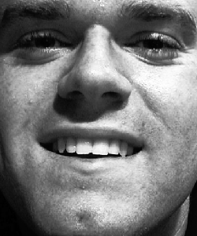
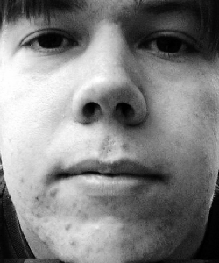
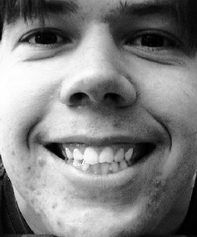
Eigenfaces, the algorithm
The database

Slide 11
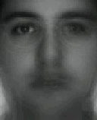
Eigenfaces, the algorithm
We compute the average face

Slide 12
Eigenfaces, the algorithm
Then subtract it from the training faces

Slide 13
Eigenfaces, the algorithm
Now we build the matrix which is N² by M
The covariance matrix which is N² by N²

Slide 14
Eigenfaces, the algorithm
Find eigenvalues of the covariance matrix
  The matrix is very large
  The computational effort is very big
We are interested in at most M eigenvalues
  We can reduce the dimension of the matrix

Slide 15
Eigenfaces, the algorithm
Compute another matrix which is M by M
Find the M eigenvalues and eigenvectors
  Eigenvectors of Cov and L are equivalent
Build matrix V from the eigenvectors of L

Slide 16
Eigenfaces, the algorithm
Eigenvectors of Cov are linear combination of image space with the eigenvectors of L
Eigenvectors represent the variation in the faces
V is Matrix of eigenvectors

Slide 17
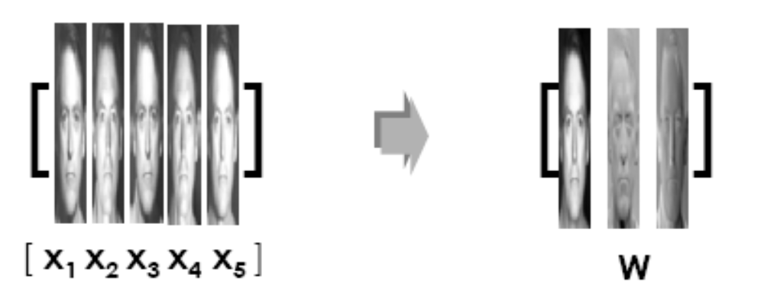
Eigenfaces, the algorithm
A: collection of the training faces
U: Face Space / Eigen Space

Slide 18
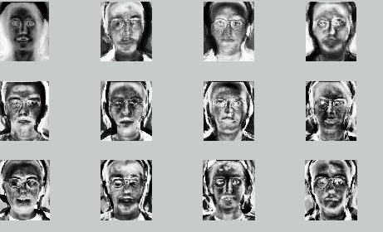
Eigenfaces
Eigenface of original faces

Slide 19
Eigenfaces, the algorithm
Compute for each face its projection onto the face space
Compute the threshold

Slide 20
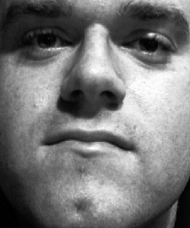
Eigenfaces: Recognition Procedure
To recognize a face
Subtract the average face from it

Slide 21
Eigenfaces, the algorithm
Compute its projection onto the face space U
Compute the distance in the face space between the face and all known faces

Slide 22
Eigenfaces, the algorithm
Reconstruct the face from eigenfaces
Compute the distance between the face and its reconstruction

Slide 23
Eigenfaces, the algorithm
Distinguish between
  If then it’s not a face; the distance between the face and its reconstruction is larger than threshold
  If then it’s a new face
  If then it’s a known face because the distance in the face space between the face and all known faces is larger than threshold

Slide 24
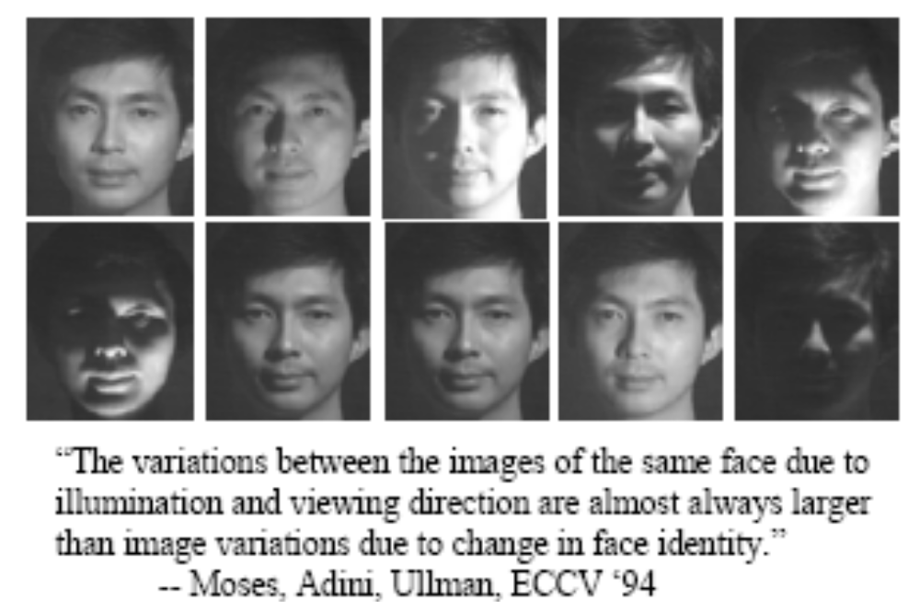
Eigenfaces, the algorithm
Problems with eigenfaces
  Different illumination

Slide 25
Eigenfaces, the algorithm
Problems with eigenfaces
  Different head pose
  Different alignment
  Different facial expression

Slide 26
Fisherfaces
Developed in 1997 by P.Belhumeur et al.
Based on Fisher’s Linear Discriminant Analysis (LDA)
Faster than eigenfaces, in some cases
Has lower error rates
Works well even if different illumination
Works well even if different facial express.

Slide 27
Fisherfaces
LDA seeks directions that are efficient for discrimination between the data
Class A
Class B

Slide 28
Fisherfaces
LDA maximizes the between-class scatter
LDA minimizes the within-class scatter
Class A
Class B

Slide 29
Fisherfaces, the algorithm
Assumptions
  Square images with Width=Height=N
  M is the number of images in the database
  P is the number of persons in the database

Slide 30
Fisherfaces, the algorithm
The database

Slide 31
Fisherfaces, the algorithm
We compute the average of all faces

Slide 32
Fisherfaces, the algorithm
Compute the average face of each person

Slide 33
Fisherfaces, the algorithm
And subtract them from the training faces

Slide 34
Fisherfaces, the algorithm
We build scatter matrices S₁, S₂, S₃, S₄
And the within-class scatter matrix S_{W}

Slide 35
Fisherfaces, the algorithm
The between-class scatter matrix
We are seeking the matrix W maximizing

Slide 36
Fisherfaces, the algorithm
If S_{W} is nonsingular ( ):
Columns of W are eigenvectors of
  We have to compute the inverse of S_{W}
  We have to multiply the matrices
  We have to compute the eigenvectors

Slide 37
Fisherfaces, the algorithm
If S_{W} is nonsingular ( ):
Simpler:
  Columns of W are eigenvectors satisfying
  The eigenvalues are roots of
  Get eigenvectors by solving

Slide 38
Fisherfaces, the algorithm
If S_{W} is singular ( ):
Apply PCA first
  Will reduce the dimension of faces from N² to M
  There are M M-dimensional vectors
Apply LDA as described

Slide 39
Fisherfaces, the algorithm
Project faces onto the LDA-space
To classify the face
  Project it onto the LDA-space
  Run a nearest-neighbor classifier

Slide 40
Fisherfaces, the algorithm
Problems
  Small databases
  The face to classify must be in the DB

Slide 41
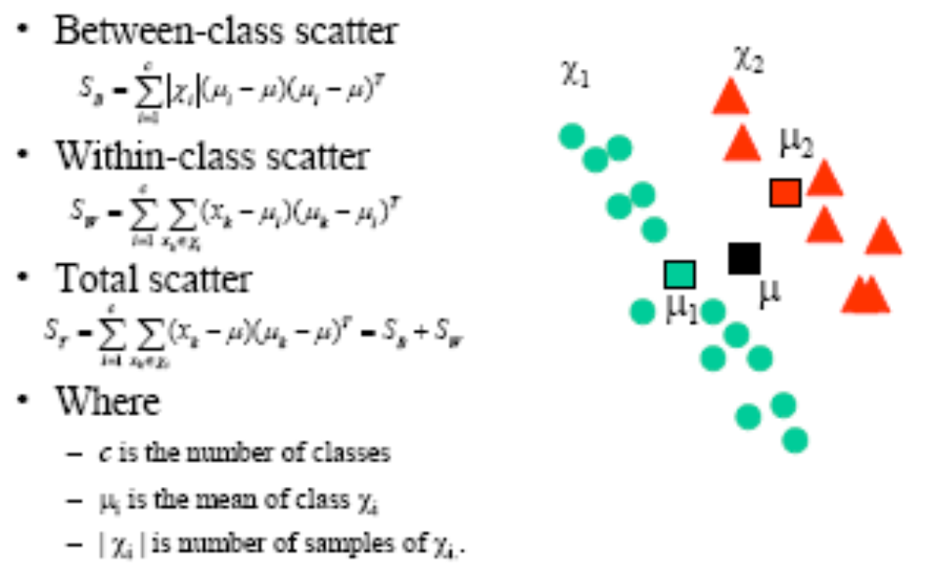
PCA & Fisher’s Linear Discriminant

Slide 42
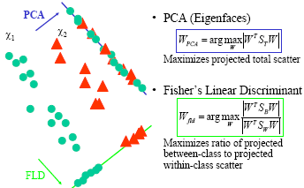
PCA & Fisher’s Linear Discriminant

Slide 43
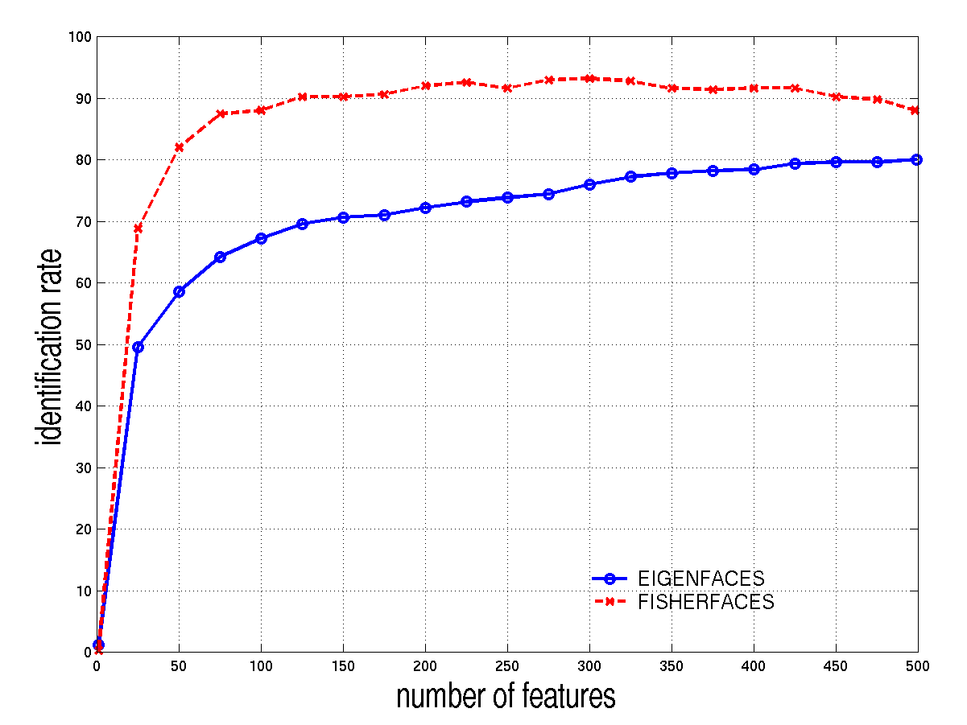
Comparison
FERET database
best ID rate: eigenfaces 80.0%, fisherfaces 93.2%

Slide 44
Comparison
Eigenfaces
  project faces onto a lower dimensional sub-space
  no distinction between inter- and intra-class variabilities
  optimal for representation but not for discrimination

Slide 45
Comparison
Fisherfaces
  find a sub-space which maximizes the ratio of inter-class and intra-class variability
  same intra-class variability for all classes

Slide 46
Local Feature Analysis
-- Elastic Bunch-Graph Matching

Slide 47
Face Features
Facial recognition utilizes distinctive features of the face – including: distinct micro elements like:
  Mouth, Nose, Eye, Cheekbones, Chin, Lips, Forehead, Ears
Upper outlines of the eye sockets, the areas surrounding the cheekbones, the sides of the mouth, and the location of the nose and eyes.
The distance between the eyes, the length of the nose, and the angle of the jaw.

Slide 48
Face Features
Some technologies do not utilize areas of the face located near the hairline, so they are somewhat resistant to moderate changes in hairstyle.
When used in identification mode, facial recognition technology generally returns candidate lists of close matches as opposed to returning a single definitive match as does fingerprint and iris-scan.
The file containing facial micro features is called a "template."
Using templates, the software then compares that image with another image and produces a score that measures how similar the images are to each other.

Slide 49
Face Features
Typical sources of images for use in facial recognition include video camera signals and pre-existing photos such as those in driver's license databases.
including:
  Distance between the micro elements
  A reference feature
  Size of the micro element
  Amount of head radiated from the face (unseen by human eye). Heat can be measured using an infrared camera.

Slide 50
A face recognition based on local feature analysis
A face is represented as a graph, whose nodes, positioned in correspondence to the facial fiducial points.
  A fiducial point is a point or line on a scale used for reference or comparison purposes.
A face recognition system uses an automatic approach to localize the facial fiducial points.
It then determines the head pose and compares the face with the gallery images.
This approach is invariant to rotation, light and scale.

Slide 51
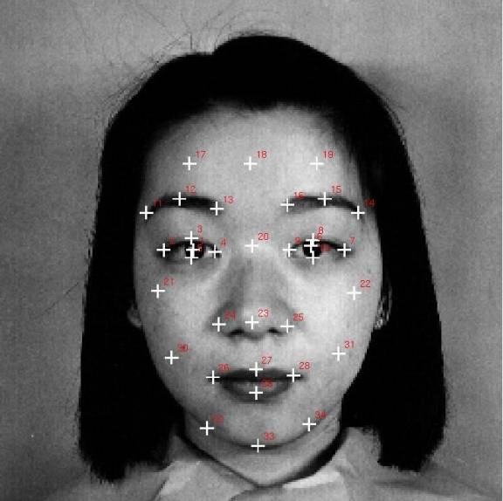
A template for the 34 fiducial points on a face image:

Slide 52
EBGM
Elastic Bunch-Graph Matching (EBGM) algorithm locates landmarks on an image, such as the eyes, nose, and mouth.
Gabor jets are extracted from each landmark and are used to form a face graph for each image. A face graph serves the same function as the projected vectors in the PCA or LDA algorithm; they represent the image in a low dimensional space.
After a face graph has been created for each test image, the algorithm measures the similarity of the face graphs.
Paper:http://www.snl.salk.edu/~fellous/posters/Bu97poster/BUPoster.pdf

Slide 53
Summary
Three algorithms have been introduced
  Eigenfaces
    Reduce the dimension of the data from N² to M
    Verify if the image is a face at all
    Allow online training
    Fast recognition of faces
    Problems with illumination, head pose etc

Slide 54
Summary
Fisherfaces
  Reduce dimension of the data from N² to P-1
  Can outperform eigenfaces on a representative DB
  Works also with various illuminations
  Can only classify a face which is “known” to DB
Elastic Bunch-Graph Matching
  Reduce the dimension of the data from N² to M
  Recognize face with different poses
  Recognize face with different expressions

Slide 55
References
[1] M. Turk, A. Pentland, “Face Recognition Using Eigenfaces”
[2] J. Ashbourn, Avanti, V. Bruce, A. Young, ”Face Recognition Based on Symmetrization and Eigenfaces”
[3] http://www.markus-hofmann.de/eigen.html
[4] P. Belhumeur, J. Hespanha, D. Kriegman, “Eigenfaces vs Fisherfaces: Recognition using Class Specific Linear Projection”
[5] R. Duda, P. Hart, D. Stork, “Pattern Classification”, ISBN 0-471-05669-3, pp. 121-124
[6] F. Perronin, J.-L. Dugelay, “Deformable Face Mapping For Person Identification”, ICIP 2003, Barcelona
[7] B. Moghaddam, C. Nastar, and A. Pentland. A bayesian similarity measure for direct image matching. ICPR, B:350–358, 1996.
http://www.face-rec.org/interesting-papers/

Slide 56
Hands-on Lab of Face Biometrics
Present one of the following algorithms
  Elastic Bunch-Graph Matching (EBGM) algorithm
  Bayesian Intrapersonal/Extrapersonal Classifier, or
  One from http://www.face-rec.org/interesting-papers/
Hands-on Lab of Face Biometrics
  http://www.cs.colostate.edu/evalfacerec/
  User Guide

